Slide 1
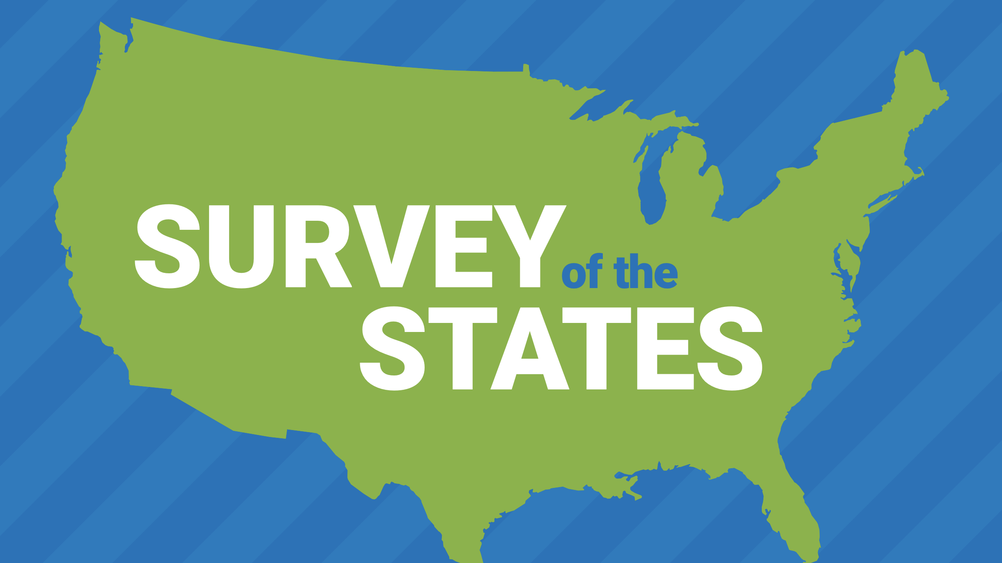
Council on Economic Education
2020
ECONOMIC AND PERSONAL FINANCE
EDUCATION IN OUR NATION’S SCHOOLS

Slide 2
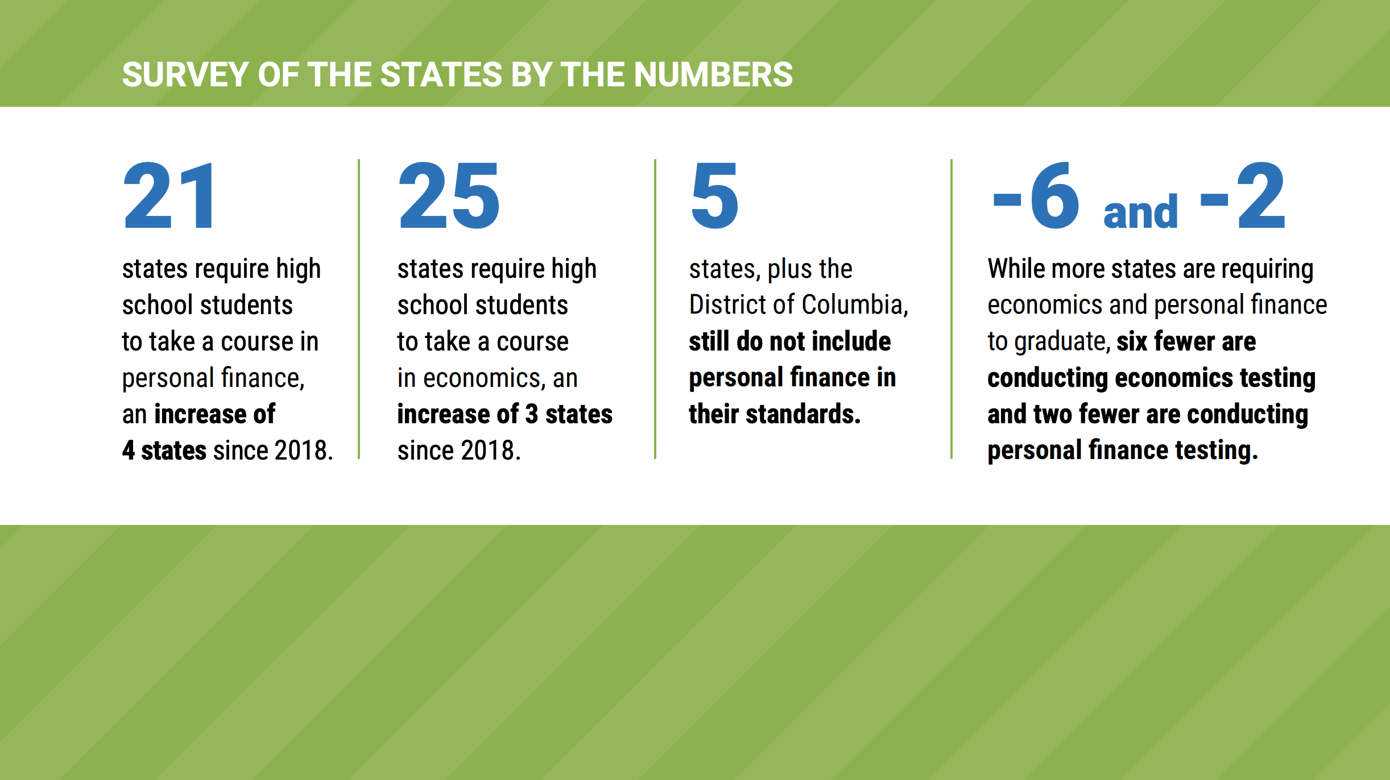
After many years of little change, the 2020 Survey shows real progress in the number of states with graduation requirements in both economics and personal finance.

Slide 3
Florida's Partial Victory
Since 2011, the FCEE has pursued a legislative requirement for a standalone course in personal finance. Finally, in 2019 the legislature passed a requirement for that course. While the bill’s passing is a victory for Florida students, it is only a partial one—legislators require only that the course be offered, not that it be taken for graduation.
88 Course Standards, Such As:
Describe how the earnings of workers are determined
Compare credit, savings, and investment services available to the consumer from financial institutions
Describe the risk and return profiles of various investment vehicles and the importance of diversification
Construct a one-year budget plan for a specific career path including expenses
Identify the impact of inflation on society
Differentiate between direct and indirect taxes, and describe the progressivity of taxes

Slide 4
Personal Financial Literacy Course
Personal Financial Literacy Course now offered as an elective to High School Students throughout the state
Students Enrolled:
25,751
67,536
9,333
Economics Course
Economics with
Financial Literacy Course
Personal Financial Literacy Course

Slide 5
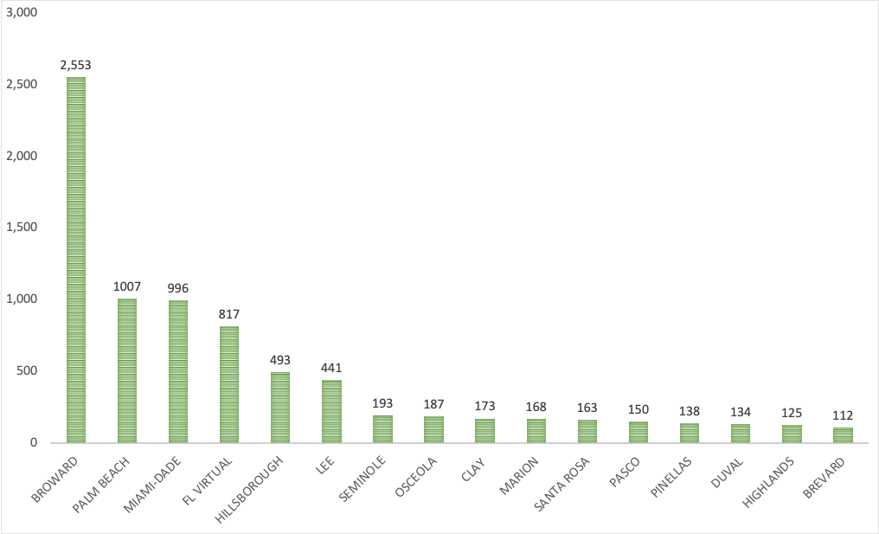
Personal Financial Literacy Course
9,333
# of Students Who Took a PFL Course by District
Students Total
51 of 67
Districts Offered Course
16
Districts had
100+ Students

Slide 6
Status of Personal Finance Education
CURRENTLY IN FLORIDA
Included in the K-12 Standards
Standards Required to Be Implemented by Districts
High School Course Required to Be Offered
Standalone High School Course Required to Be Taken
Required Coursework Integrated into Another Course
Standardized Testing
FLORIDA’S GOAL
Included in the K-12 Standards
Standards Required to Be Implemented by Districts
High School Course Required to Be Offered
Standalone High School Course Required to Be Taken
Required Coursework Integrated into Another Course
Standardized Testing

